Slide 1

KLE Technological
University
Dr. M. S. Sheshgiri Campus, Belagavi
Department of Computer Science & Engineering
Creating Value
Leveraging Knowledge
Machine Learning and Deep Learning Course Project: Project Title :-
Watermelon Leaf and Fruit Disease Prediction Using VGG16
Division :A
Team No: 17
Guided by:Dr Prema Akkasaligar
NAME | SRN | ROLL NO
1)Soukhya Nayak | 02FE22BCS148 | 47
2)Sharanamma Katti | 02FE22BCS119 | 36
3)Abhishek Angadi | 02FE22BCS005 | 03
4)Prem Vhankhande | 02FE22BCS072 | 23

Slide 2
Introduction
Purpose: Addresses the need for efficient, machine vision-based detection models to combat crop diseases in watermelon cultivation.
Dataset Collection:
Collected on June 25, 2023, from the Regional Horticulture Research Station in Patuakhali, Bangladesh.
Includes both healthy and diseased watermelon images.
Categories: The dataset enables classification into four categories:
Healthy
Mosaic Virus
Anthracnose
Downy Mildew
Dataset Composition:
Contains 1155 original images.
Augmented to include a total of 5775 images, enhancing the dataset's robustness for training models.

Slide 3
5. Availability:
Publicly accessible on the Mendeley repository.
Supports research and development of early disease detection algorit.
6.Impact:
Aims to empower farmers with early diagnosis tools.
Contributes to agricultural stability and food security by minimizing crop losses.

Slide 4
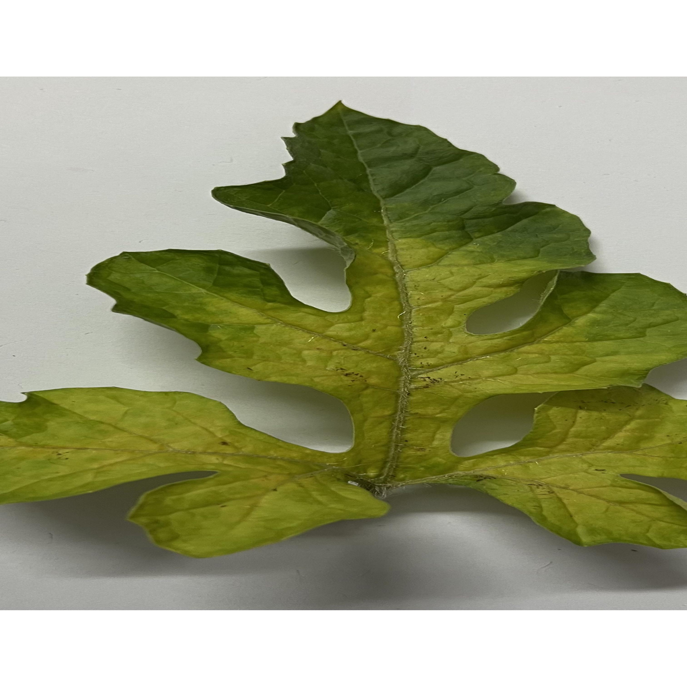
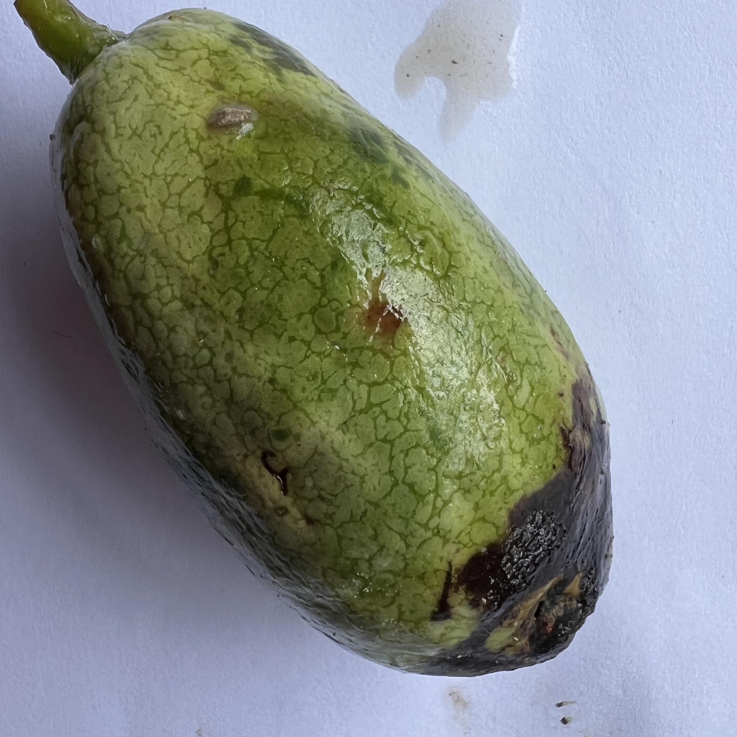
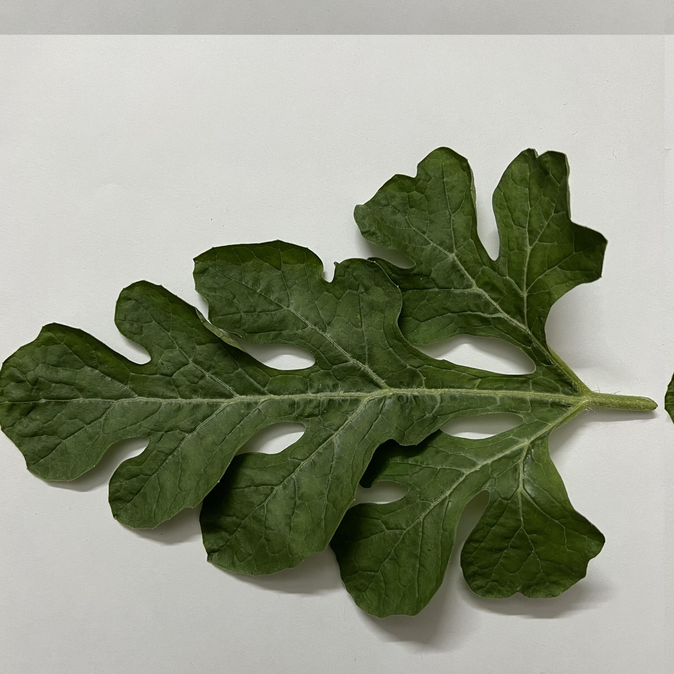
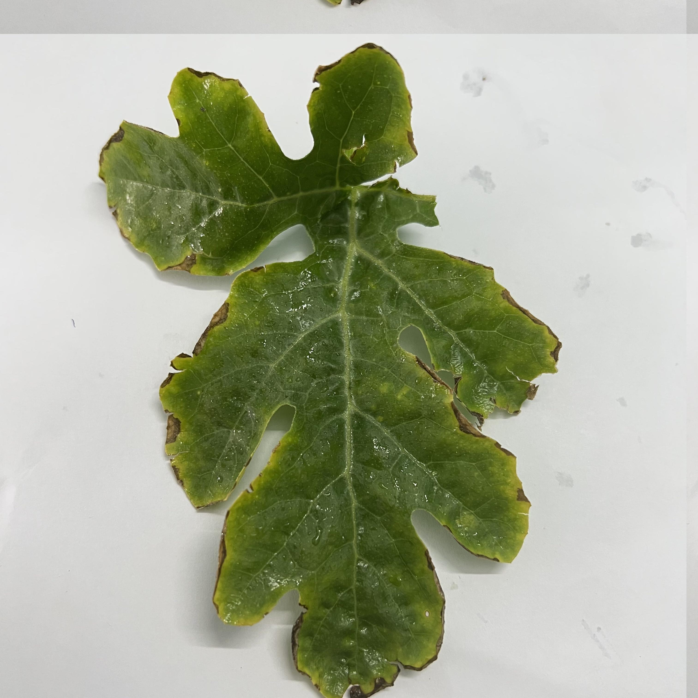
Mosaic_Virus Healthy Downy_Mildew Anthracnose

Slide 5
Literature Review
S.No | Title | Methodology/Implementation | Dataset Description | PerformanceParameter | Limitations | Gaps Identified | Year
1 | Hybrid RNN and RFfor WMV severity-2024 In[2] | RNN and Random Forest | 16000 images of WMV | Accuracy 99.08% | Long train-ing time | Data variety and image quality issues | 2024
2 | UAV data for melonleaf disease detection-2024 In[11] | UAV, YOLOv8 for dis-ease detection | UAV images | Accuracy 83.2% | Limiteddataset | Need for larger-scale validation | 2024
3 | Detection of bacterialinfection in melons-2024 In[12] | Imaging data, ML (ANN,SVM) | Melon leaves dataset | ANN accuracy 99.1% | Lowaccuracyfor non-infectedregions | Further refinement needed | 2024
4 | Federated learning forwatermelon diseasedetection-2024 In[13] | Federated Learning (FL),CNN | Five distinct disease data sub-sets | Accuracy 96-97% | High com-putationalresourcesneeded | Improve client communication reliabil-ity | 2024

Slide 6
Course project objectives
To enable the early detection of watermelon diseases.
To minimize crop losses through timely intervention.
To achieve high classification accuracy by utilizing deep learning models.
To distinguish between different disease categories effectively.

Slide 7
Dataset Description
Four types of watermelon disease in folders
There are totally 5775 images
Mosaic_Virus = 1043images
Healthy = 205images
Downy_Mildew = 375images
Anthracnose = 4152 images
Mosaic_Virus Healthy Downy_Mildew Anthracnose

Slide 8
Website link to download dataset.
https://www.kaggle.com/datasets/sujaykapadnis/watermelon-disease-recognition-dataset

Slide 9
Watermelon diseases, like mosaic virus and anthracnose significantly cause crop damage. Automated systems based on machine learning and deep learning have the capability to attain faster and more accurate diagnosis as compared to the traditional manual methods . The identification of diseases of watermelon as namely healthy, mosaic virus, anthracnose, and downyn mildew. The challenge is to design an automated system that classifies watermelon diseases with maximum accuracy from the images of the leaves.
PROPOSED METHODOLOGY

Slide 10
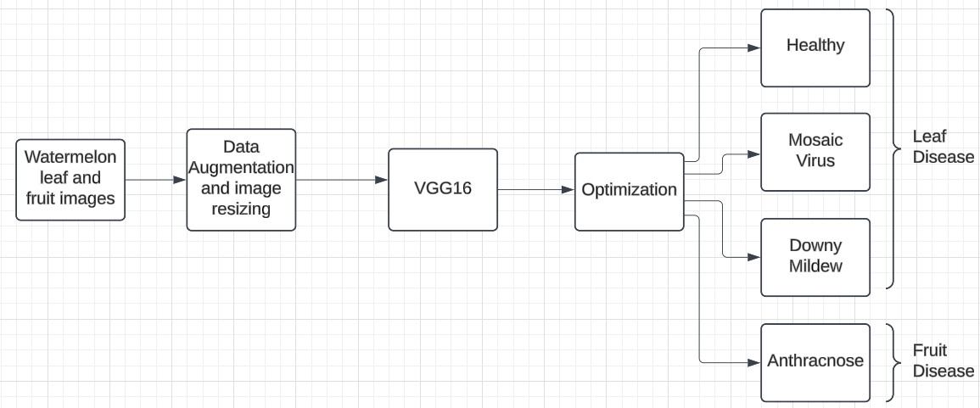
PROPOSED METHODOLOGY

Slide 11
PROPOSED METHODOLOGY
The proposed methodology for classifying watermelon fruit and leaf diseases is illustrated in Fig. 1. The suggested watermelon disease detection system includes several essential modules to ensure precise and effective classification.
The main goal of the data gathering phase is to capture images of both healthy and diseased watermelon leaves from the regional horticulture research station in Patuakhali, Bangladesh.
The dataset contains various categories, including downy mildew, anthracnose, mosaic virus, and healthy .To increase robustness and avoid overfitting, data augmentation methods such as rotation, flipping, zooming, and shifting are applied. This process produces a large dataset comprising both enhanced and original images .In the data preprocessing stage, all images are standardized to a uniform size (e.g., 224x224 pixels) and normalized to scale pixel values between -1 and 1 for better convergence during training.
Additional augmentation techniques, such as rotation and zooming, are applied to enhance the model’s generalization capabilities.

Slide 12
The dataset is then split into training(70%), validation (15%), and testing (15%) subsets, ensuring balanced representation of all categories across the splits . The model has well-known CNN architecture VGG16.
The architecture is fine-tuned by customizing convolutional layers, activation functions (ReLU), pooling layers, and fully connected layers to suit the dataset’s complexity . The training process involves monitoring validation performance to prevent overfitting while optimizing the model using techniques such as Adam optimizers, learning rate scheduling, dropout, batch normalization, and early stopping . Real-time data augmentation is applied during training to further enhance the models performance.
Finally, the evaluation is made to the trained model .It is testing on the reserved test set, and its performance is assessed using metrics like accuracy, precision, recall, F1-score, and a confusion matrix. Error analysis of misclassified images is conducted to identify potential improvements. The systematic approach ensures high accuracy and reliability in detecting watermelon diseases.

Slide 13
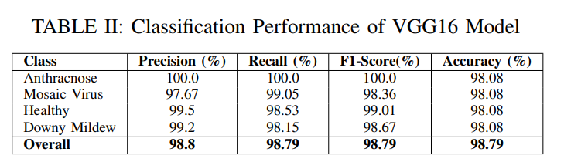
Hyper Parameters-
Optimizer-Adam
Learning Rate-0.0005
Loss Function –Categorical Crossentrophy
Metrics-Accuracy
Batchsize-32
Epochs-30

Slide 14
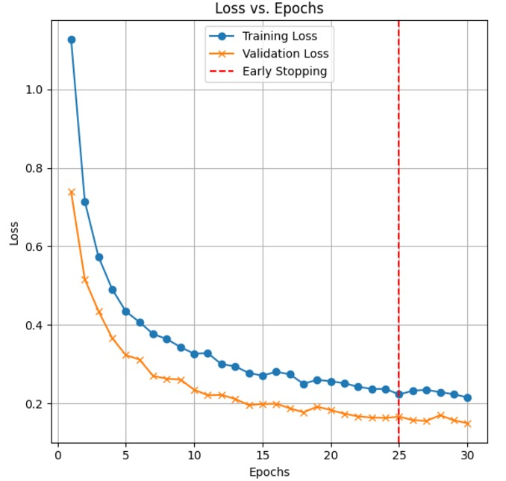
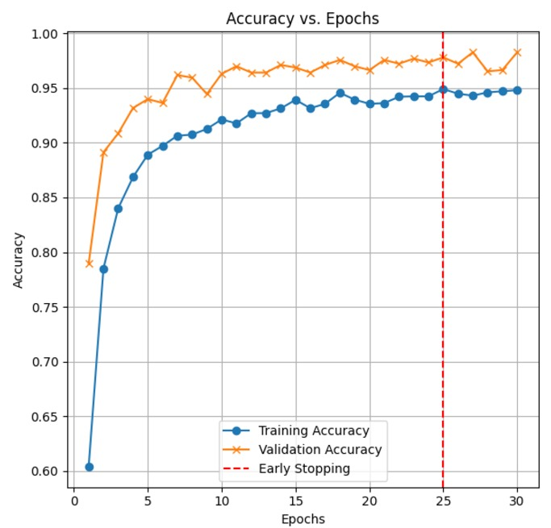
Results

Slide 15
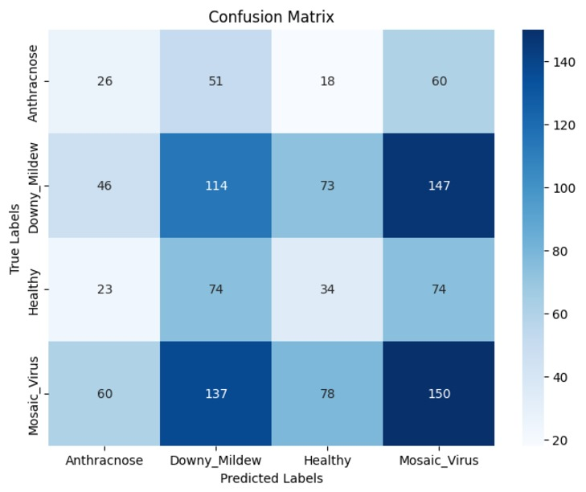

Slide 16
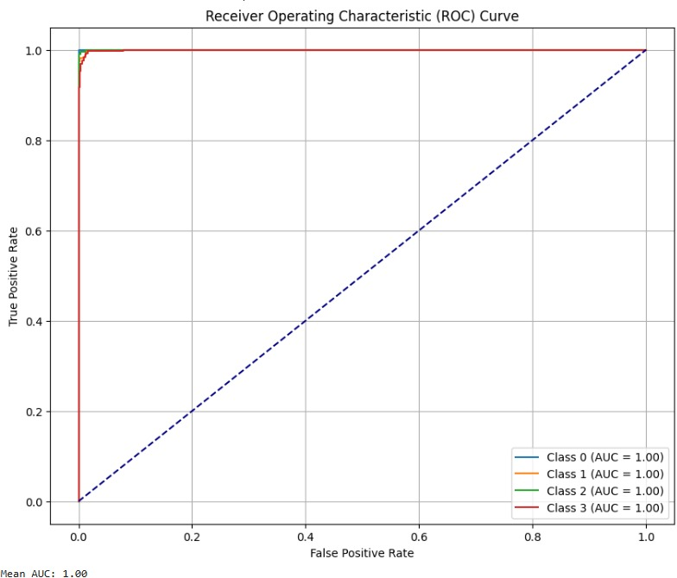

Slide 17
CONCLUSION
This project proposes a VGG16-based model for predicting watermelon leaf and fruit diseases, using data augmentation and regularization (e.g., dropout) to prevent overfitting and ensure strong generalization. The model aims to identify diseases like anthracnose, downy mildew, and mosaic virus, which can significantly impact crop health and yield. By leveraging transfer learning, the model efficiently extracts features from high-quality images of diseased and healthy watermelon plants, achieving 98.79% accuracy. This approach helps in early disease detection, enabling farmers to take timely actions, thus improving crop health and reducing losses. The VGG16 model is highlighted as an effective and reliable tool for agricultural disease classification.

Slide 18
References
1] Moya-Ruiz C, G´omez P, Ju´arez M. Occurrence, Distribution, andManagement of Aphid-Transmitted Viruses in Cucurbits in Spain.Pathogens. 2023 Mar 7;12(3):422. doi: 10.3390/pathogens12030422.PMID: 36986344; PMCID: PMC10057868.
[2] D. Arora, K. Mehta, A. Kumar, and S. Lamba, “Evaluating WatermelonMosaic Virus Seriousness with Hybrid RNN and Random Forest Model:A Five-Degree Approach,” in Proceedings of the 2024 11th InternationalConference on Reliability, Infocom Technologies and Optimization(Trends and Future Directions) (ICRITO), Noida, India, 2024, pp. 1-5, doi: 10.1109/ICRITO61523.2024.10522240.
[3] S. Swain, S. K. Nayak, S. Sucharita, and A. Barik,“A Review on Plant Leaf Diseases Detection and Clas-sification Based on Machine Learning Models,” 2020.[Online]. Available: https://www.semanticscholar.org/paper/A-Review-on-Plant-Leaf-Diseases-DetectionandBased-Swain-Nayak/5ac88f43e168d1fb40d40aae9186470bae3594d7
.[4] B. S. Abu-Nasser and S. S. Abu-Naser, “Cognitive Expert System forWatermelon Disease Diagnosis and Treatment,” International Journal ofAcademic Information Systems Research, vol. 2, no. 7, pp. 1–7, 2018,hal-01855441.

Slide 19
[5] S. B. Kutty , “RGB Color Extraction-Based System for ClassifyingWatermelon Leaf Diseases,” in Proceedings of the 2021 BusinessEngineering and Industrial Applications Colloquium (BEIAC),2021, doi: 10.1109/BEIAC.2021.6560170. [Online]. Available:https://www.researchgate.net/publication/261264177
[6] J. Abdulridha, Y. Ampatzidis, J. Qureshi, and P. Roberts, “Identifi-cation and Classification of Downy Mildew Severity Stages in Wa-termelon Utilizing Aerial and Ground Remote Sensing and MachineLearning,” Frontiers in Plant Science, vol. 13, p. 791018, 2022, doi:10.3389/fpls.2022.791018
[7] S. S. Harakannanavar , “CNN-Based Early Detection of Plant Diseasesin Tomato Leaves,” Global Transitions Proceedings, vol. 3, no. 11,pp. 1-8, 2022, doi: 10.1016/j.gltp.2022.03.016. [Online]. Available:https://www.researchgate.net/publication/359690037.
[8] J. Doe , “Detection of Cucumber and Watermelon Diseases Based onImage Processing Techniques Using K-Means Algorithm,” InternationalJournal of Multidisciplinary Research and Growth Evaluation, vol. 4,pp. 38-46, 2023, doi: 10.54660/.IJMRGE.2023.4.6.38-46.
[9] H. S. Jayswal , “Various Plant Disease Detection Methods (CNN, SVM,Mobile Apps),” Plant Leaf Disease Detection and Classification usingConventional Machine Learning and Deep Learning, Jan. 2020. [Online].Available: https://www.researchgate.net/publication/352787124[10

Slide 20
[10] D. Jayakumar , “Automatic Prediction and Classification of Diseasesin Melons Using Stacked RNN Based Deep Learning Model,” in Pro-ceedings of the 2020 International Conference on System, Computation,Automation and Networking (ICSCAN), Pondicherry, India, 2020, pp.1-5, doi: 10.1109/ICSCAN49426.2020.9262414.
[11] S. N. A. Robi , “Utilizing UAV Data for Neural Network-Based Clas-sification of Melon Leaf Diseases in Smart Agriculture,” InternationalJournal of Advanced Computer Science and Applications (IJACSA), vol.15, no. 1, 2024, doi: 10.14569/IJACSA.2024.01501119.
[12] M. Pineda , “Detection of Bacterial Infection in Melon Plants byClassification Methods Based on Imaging Data,” Frontiers in PlantScience, vol. 9, p. 164, 2018, doi: 10.3389/fpls.2018.00164.
[13] A. Suryavanshi , “Agriculture Farming Evolution: Federated Learn-ing CNNs in Combatting Watermelon Leaf Diseases,” in Pro-ceedings of the 2024 Asia Pacific Conference on Innovationin Technology (APCIT), Mysore, India, 2024, pp. 1-6, doi:10.1109/APCIT62007.2024.10673452.

